Slide 1
Budget Sales Analysis

Slide 2
1. Problem Statement:
Our "Domain Sale" process is structured to help potential buyers purchase the domain they want immediately without the hassle of contacting the seller directly. A seller lists a domain for sale at a specific price in our Marketplace. An interested buyer sees this domain for sale and decides to buy it.

Slide 3
2. Objectives:
The collection includes records for sales orders, customer information, product information, and geographical data.
In order to deduce important metrics and patterns in the dataset, this project will use the provided data to perform ETL and data analysis.
Additionally, several visualisations and reports are created to represent significant linkages.

Slide 4
3. Benefits
Help in making wiser business decisions.
Aid in customer satisfaction and trend monitoring, which can serve current consumers and attract new ones.
Greater client base understanding is provided.
Facilitates seamless resource management flow.

Slide 5
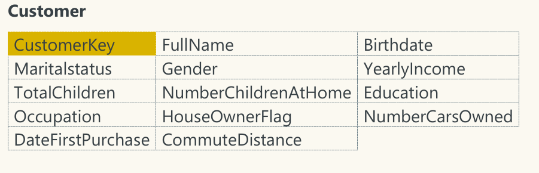
4. Data attributes

Slide 6
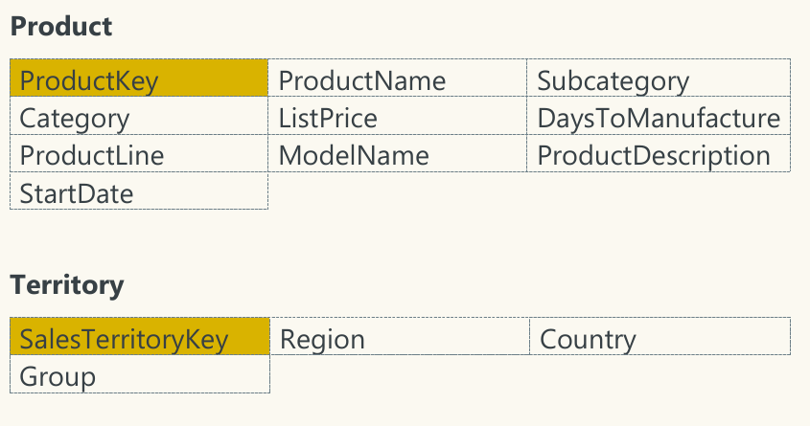

Slide 7
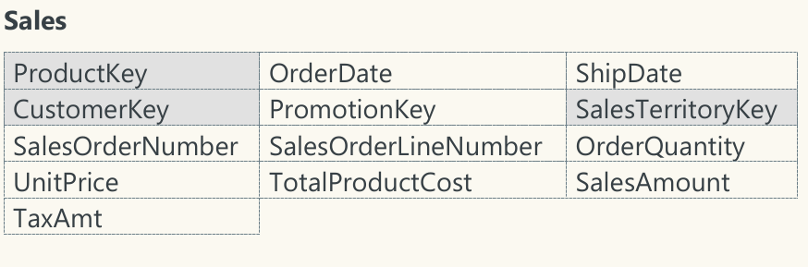

Slide 8
4.1 Dataset information
CustomerKey: Primary key for customer dataset
Birthdate: Birthdate of the customer
MaritalStatus: M- Married / S - Single Gender: M – Male / F – Female
TotalChildren: Total number of children
NumberChildrenAtHome: Number of children staying along with their parents
Education: Education qualification
Occupation: Present occupation
HouseOwnerFlag: 1– Owns house / 0- Doesn’t have a permanent address
NumberCarsOwned: Number of cars owned by the customer
DateFirstPurchase: First date of order by the customer
ProductKey: Primary Key for the product dataset
ProductName: Product name with colour of the product
Subcategory: Sub category name of the product
Category: Category name of the product
ListPrice: Sale price of the product
DaysToManufacture: Days to manufacture the product after receiving the order
ProductLine: Product line name
ModelName: Model name of the product
ProductDescription: more details about the product

Slide 9
SalesTerritoryKey: Primary Key of the Territory dataset
Region: Region name of the order
Country: Country name of the order
OrderDate: Date of the order received
ShipDate: Date when the order left the factory for export
SalesOrderNumber: Invoice number of the order
OrderQuantity: Number of quantities ordered for a product
UnitPrice: Per unit sale price of the product
TotalProductCost: Cost of the product
SalesAmount: Total sales price of the product
TaxAmt: Tax collected for the product sold

Slide 10
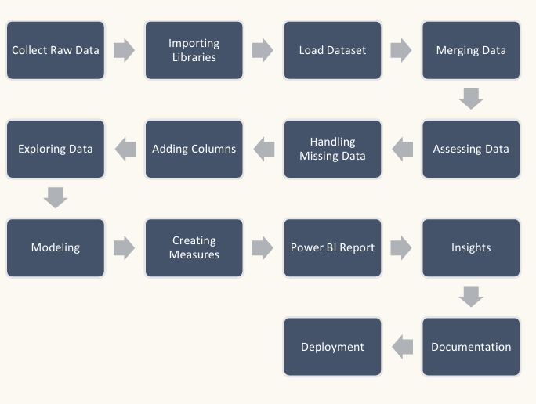
5. Architecture

Slide 11
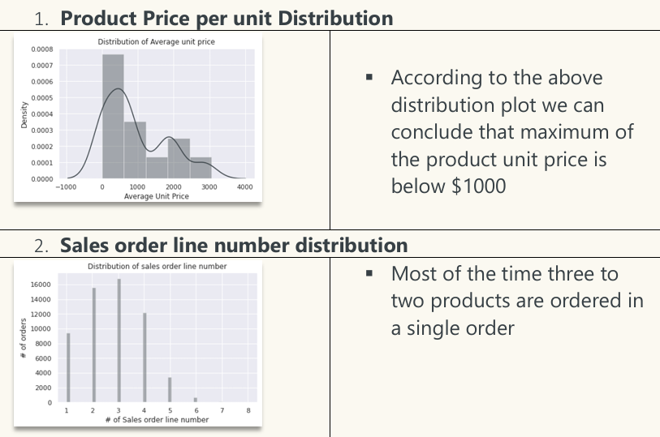
6. Insights

Slide 12
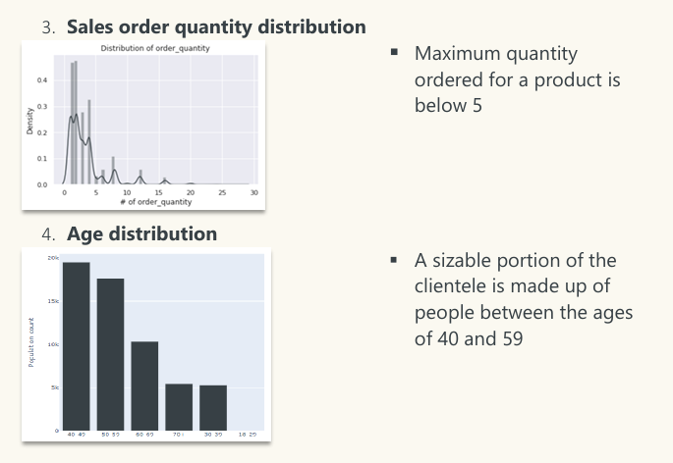

Slide 13
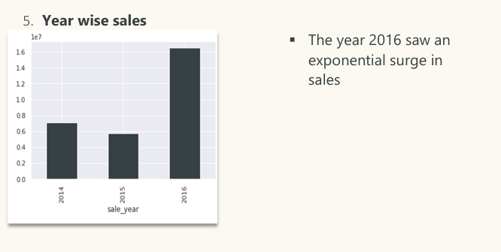
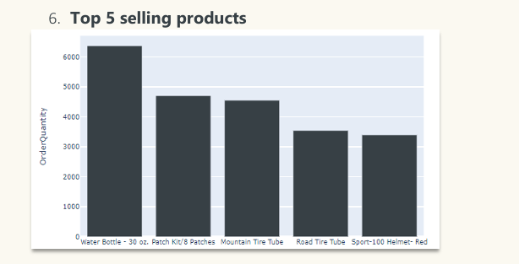

Slide 14
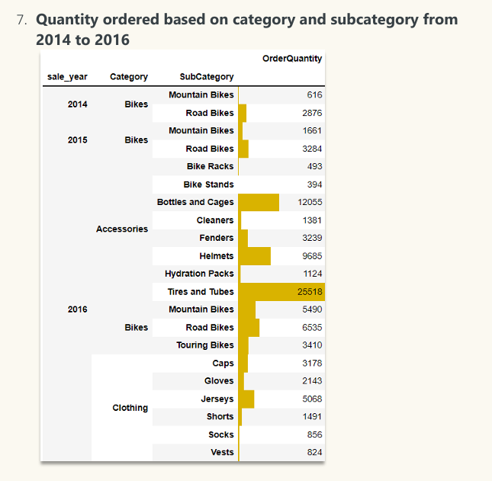

Slide 15
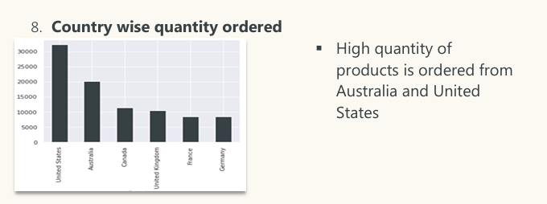

Slide 16
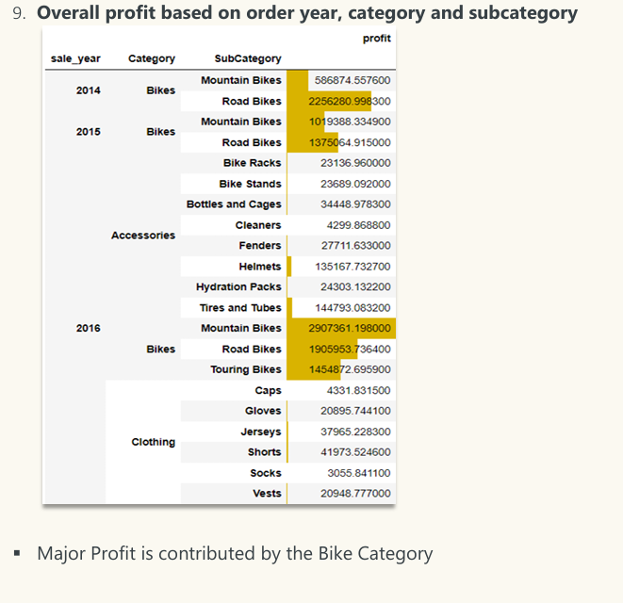

Slide 17
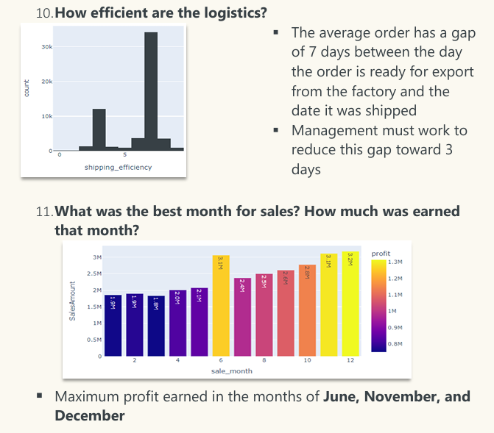

Slide 18
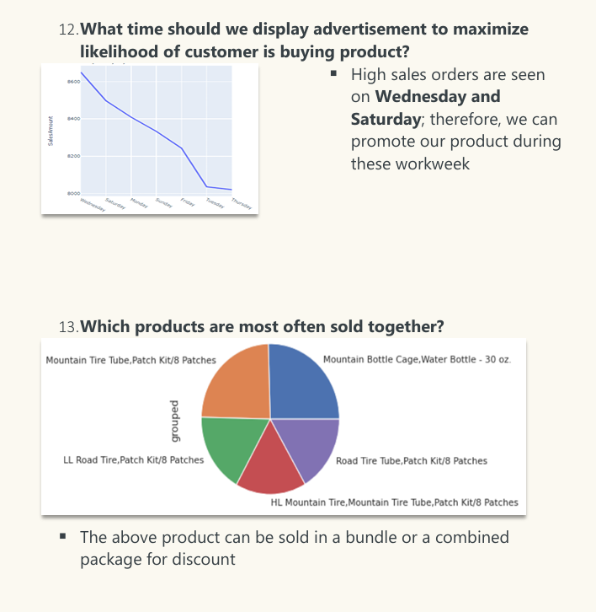

Slide 19
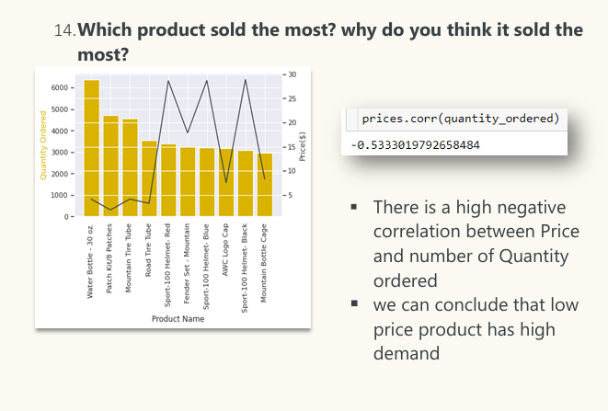

Slide 20
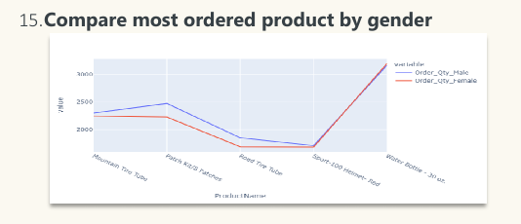
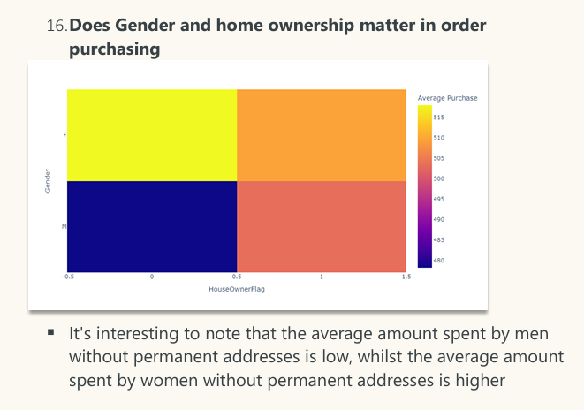

Slide 21
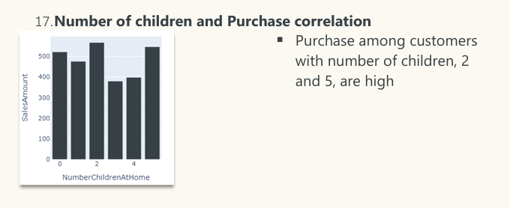
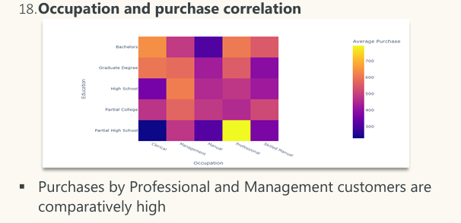

Slide 22
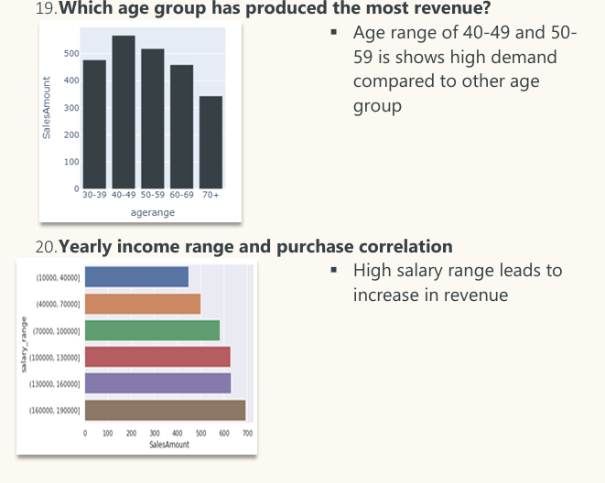

Slide 23
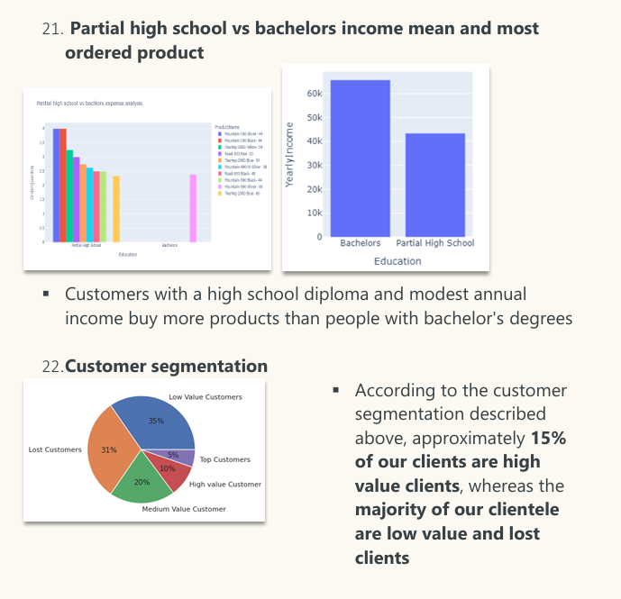

Slide 24
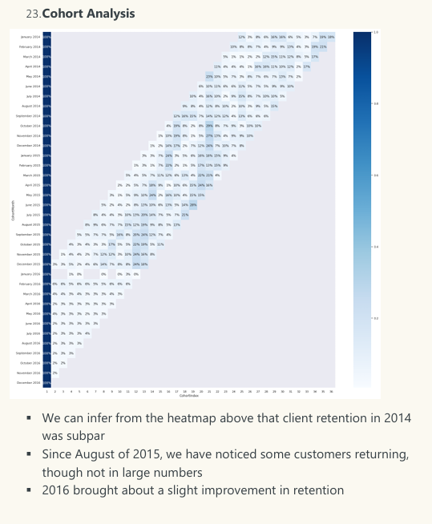

Slide 25
7. Key Performance Indicator
▪ Sales trend line
▪ Cost trend line
▪ Average unit cost and price
▪ Revenue generated by Subcategory
▪ Sales by Product Line
▪ Revenue contribution by region
▪ Profit contribution by region
▪ Profit % by region
▪ Current year profit margin vs difference in last year’s profit margin
▪ Total orders
▪ Total revenue
▪ Variance to target comparison by category
▪ Variance by month line chart
▪ Actual sales and target sales matrix
▪ Cohort analysis table
▪ Customer retention line chart
▪ Monthly spending trend
▪ Average monthly spend distribution

Slide 26
8. Conclusion
A sizable portion of the clientele is made up of people between the ages of 40 and 59
The year 2016 saw an exponential surge in sales
High quantity of products is ordered from Australia and United States
Major Profit is contributed by the Bike Category
The average order has a gap of 7 days between the day the order is ready for export from the factory and the date it was shipped
Maximum profit earned in the months of June, November, and December
High sales orders are seen on Wednesday and Saturday, when compared to other weekdays
There is a high negative correlation between Price and number of Quantity ordered
The average amount spent by men without permanent addresses is low, whilst the average amount spent by women without permanent addresses is higher

Slide 27
Age range of 40-49 and 50-59 is shows high demand compared to other age group
High salary range leads to increase in revenue
Customers with a high school diploma and modest annual income buy more products than people with bachelor's degrees
According to the customer segmentation described above, approximately 15% of our clients are high value clients, whereas the majority of our clientele are low value and lost clients
Client retention in 2014 was subpar
2016 brought about a slight improvement in retention

